Slide 1

College Changes Everything Conference
Nancy L. Zimpher, Chancellor
State University of New York
Chicago, IL
July 16-17, 2014

Slide 2

The Power of SUNY
A Big, Hairy Audacious Goal:
SUNY will be a key engine of revitalization for New York State’s economy and enhance the quality of life of the state’s citizens.

Slide 3

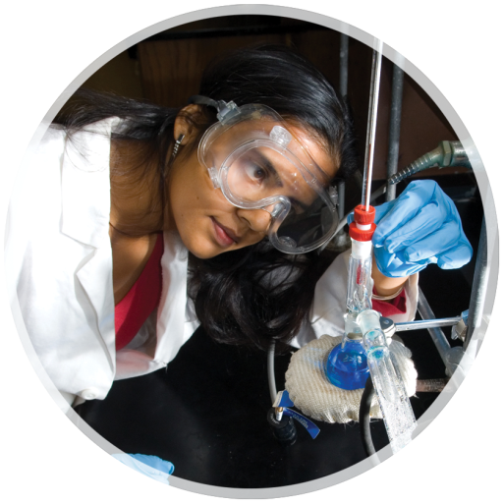

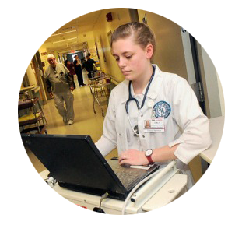
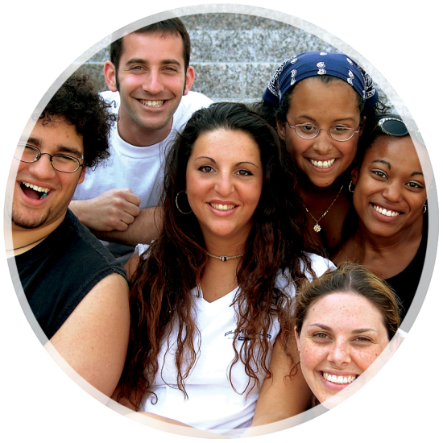
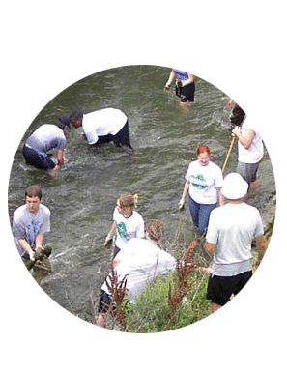
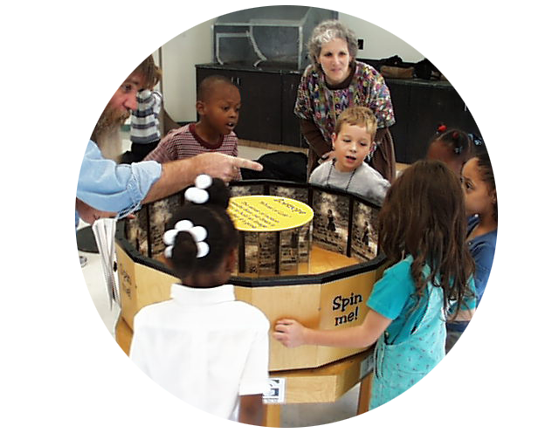
SIX BIG IDEAS
SUNY and the Entrepreneurial
Century
SUNY and an Energy-Smart New York
SUNY and a
Healthier New York
SUNY and the
World
SUNY and the Seamless Education Pipeline
SUNY and the
Vibrant Community

Slide 4

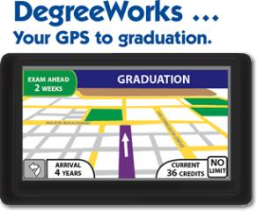

A + C = S
ACCESS
COMPLETION
SUCCESS
Seamless Transfer

Slide 5
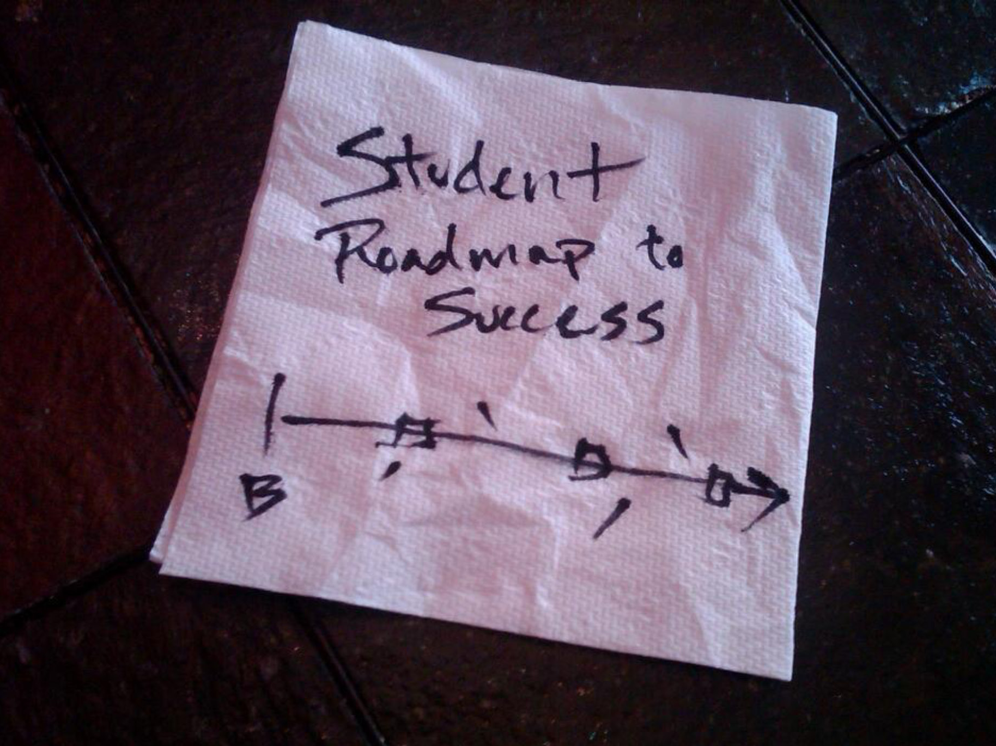

Slide 6
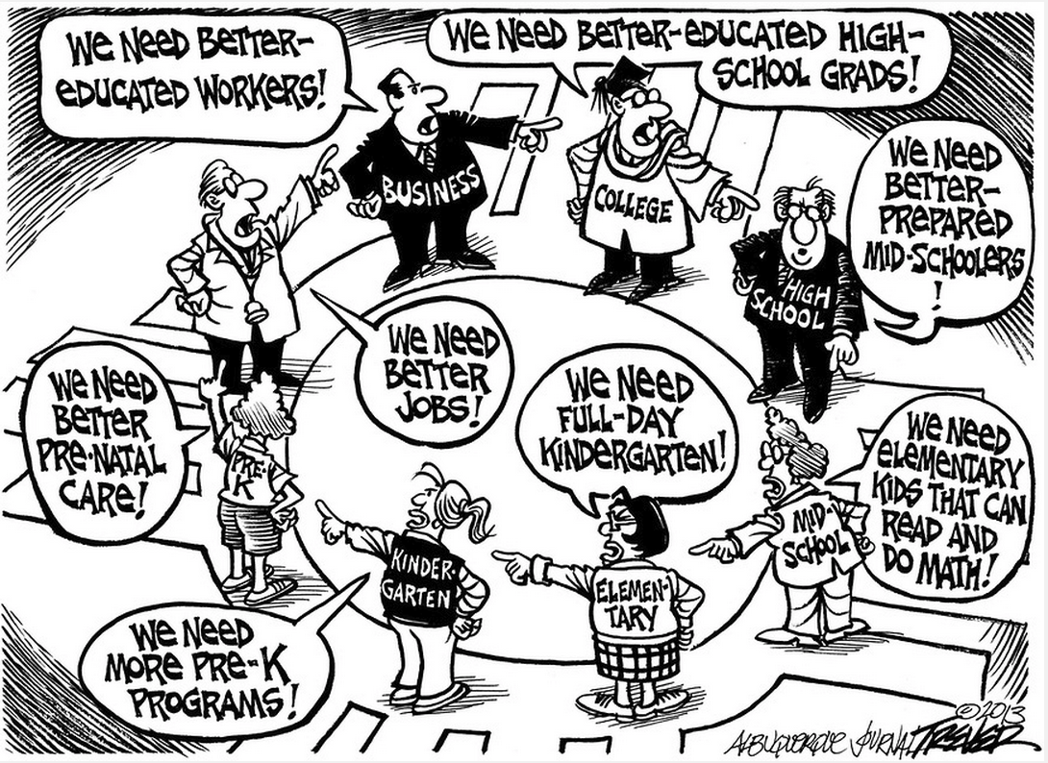

Slide 7
Quick Story:
Improving Outcomes for Children in Cincinnati & Northern Kentucky

Slide 8
High School Graduation/College Retention Rates

Slide 9
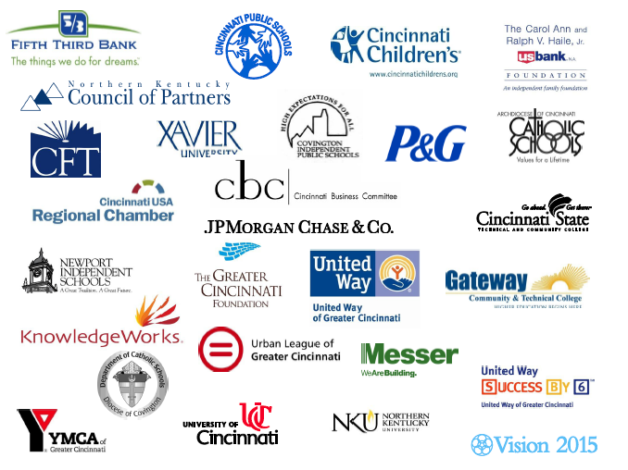
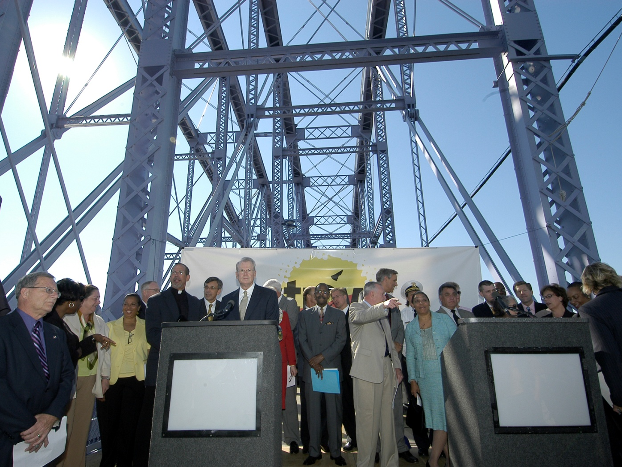


Slide 11
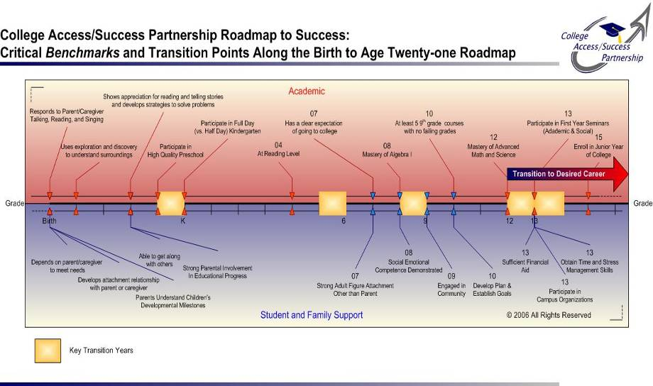

Slide 12

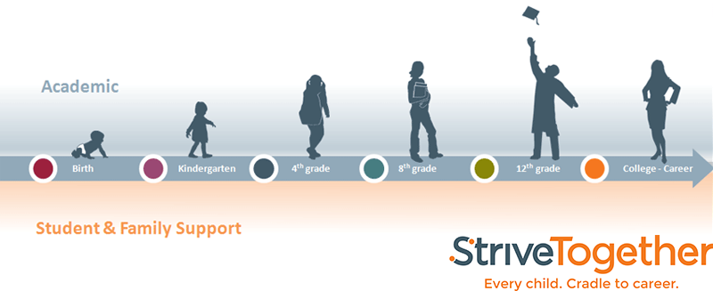

Slide 13
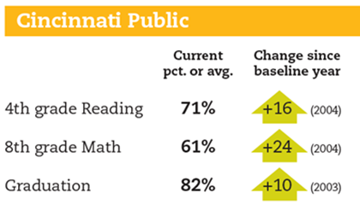
Focus on Outcomes
Kindergarten Readiness in Literacy
4th Grade Reading
8th Grade Math
High School Graduation
College Readiness
College Entrance
College Retention
Degree/Certification Completion

Slide 14
Proven Local Success:
Percentage of Outcomes Trending Positively
89%
81%
85
80
75
70
65
60
74%
68%
Percentage
2009 2010 2011 2012
Report Card Year
Notes:
Rooted in local success, outcomes trending in the right direction

Slide 16



Slide 17
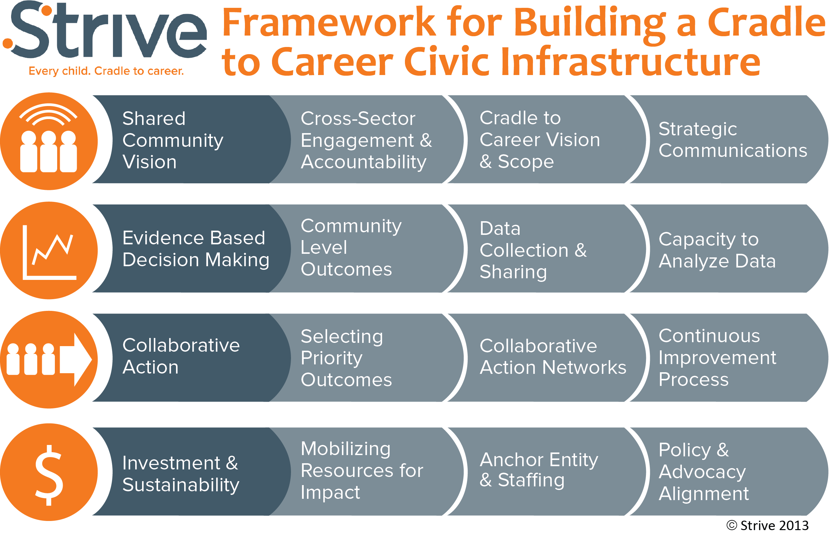

Slide 18
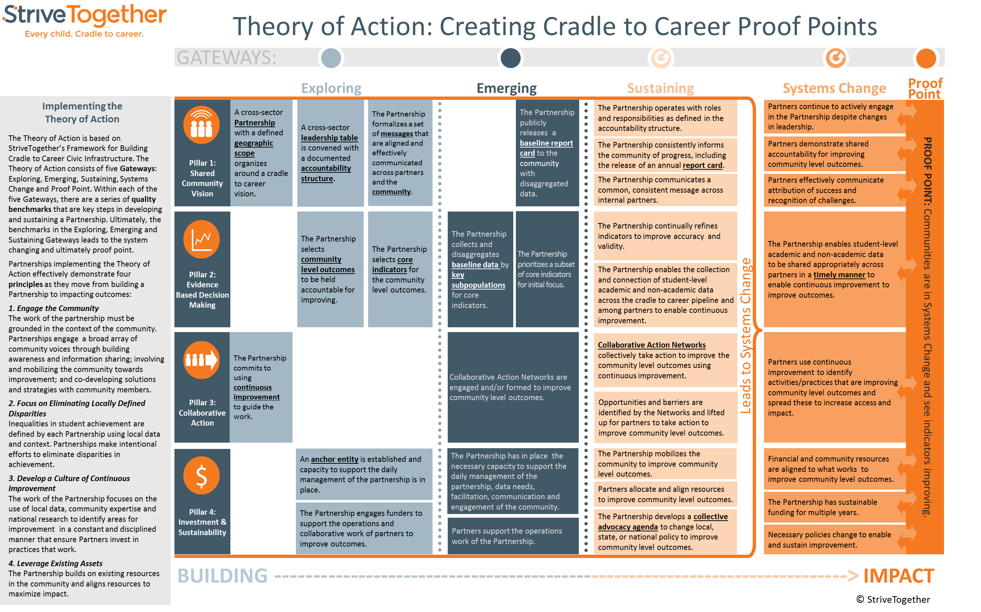

Slide 19
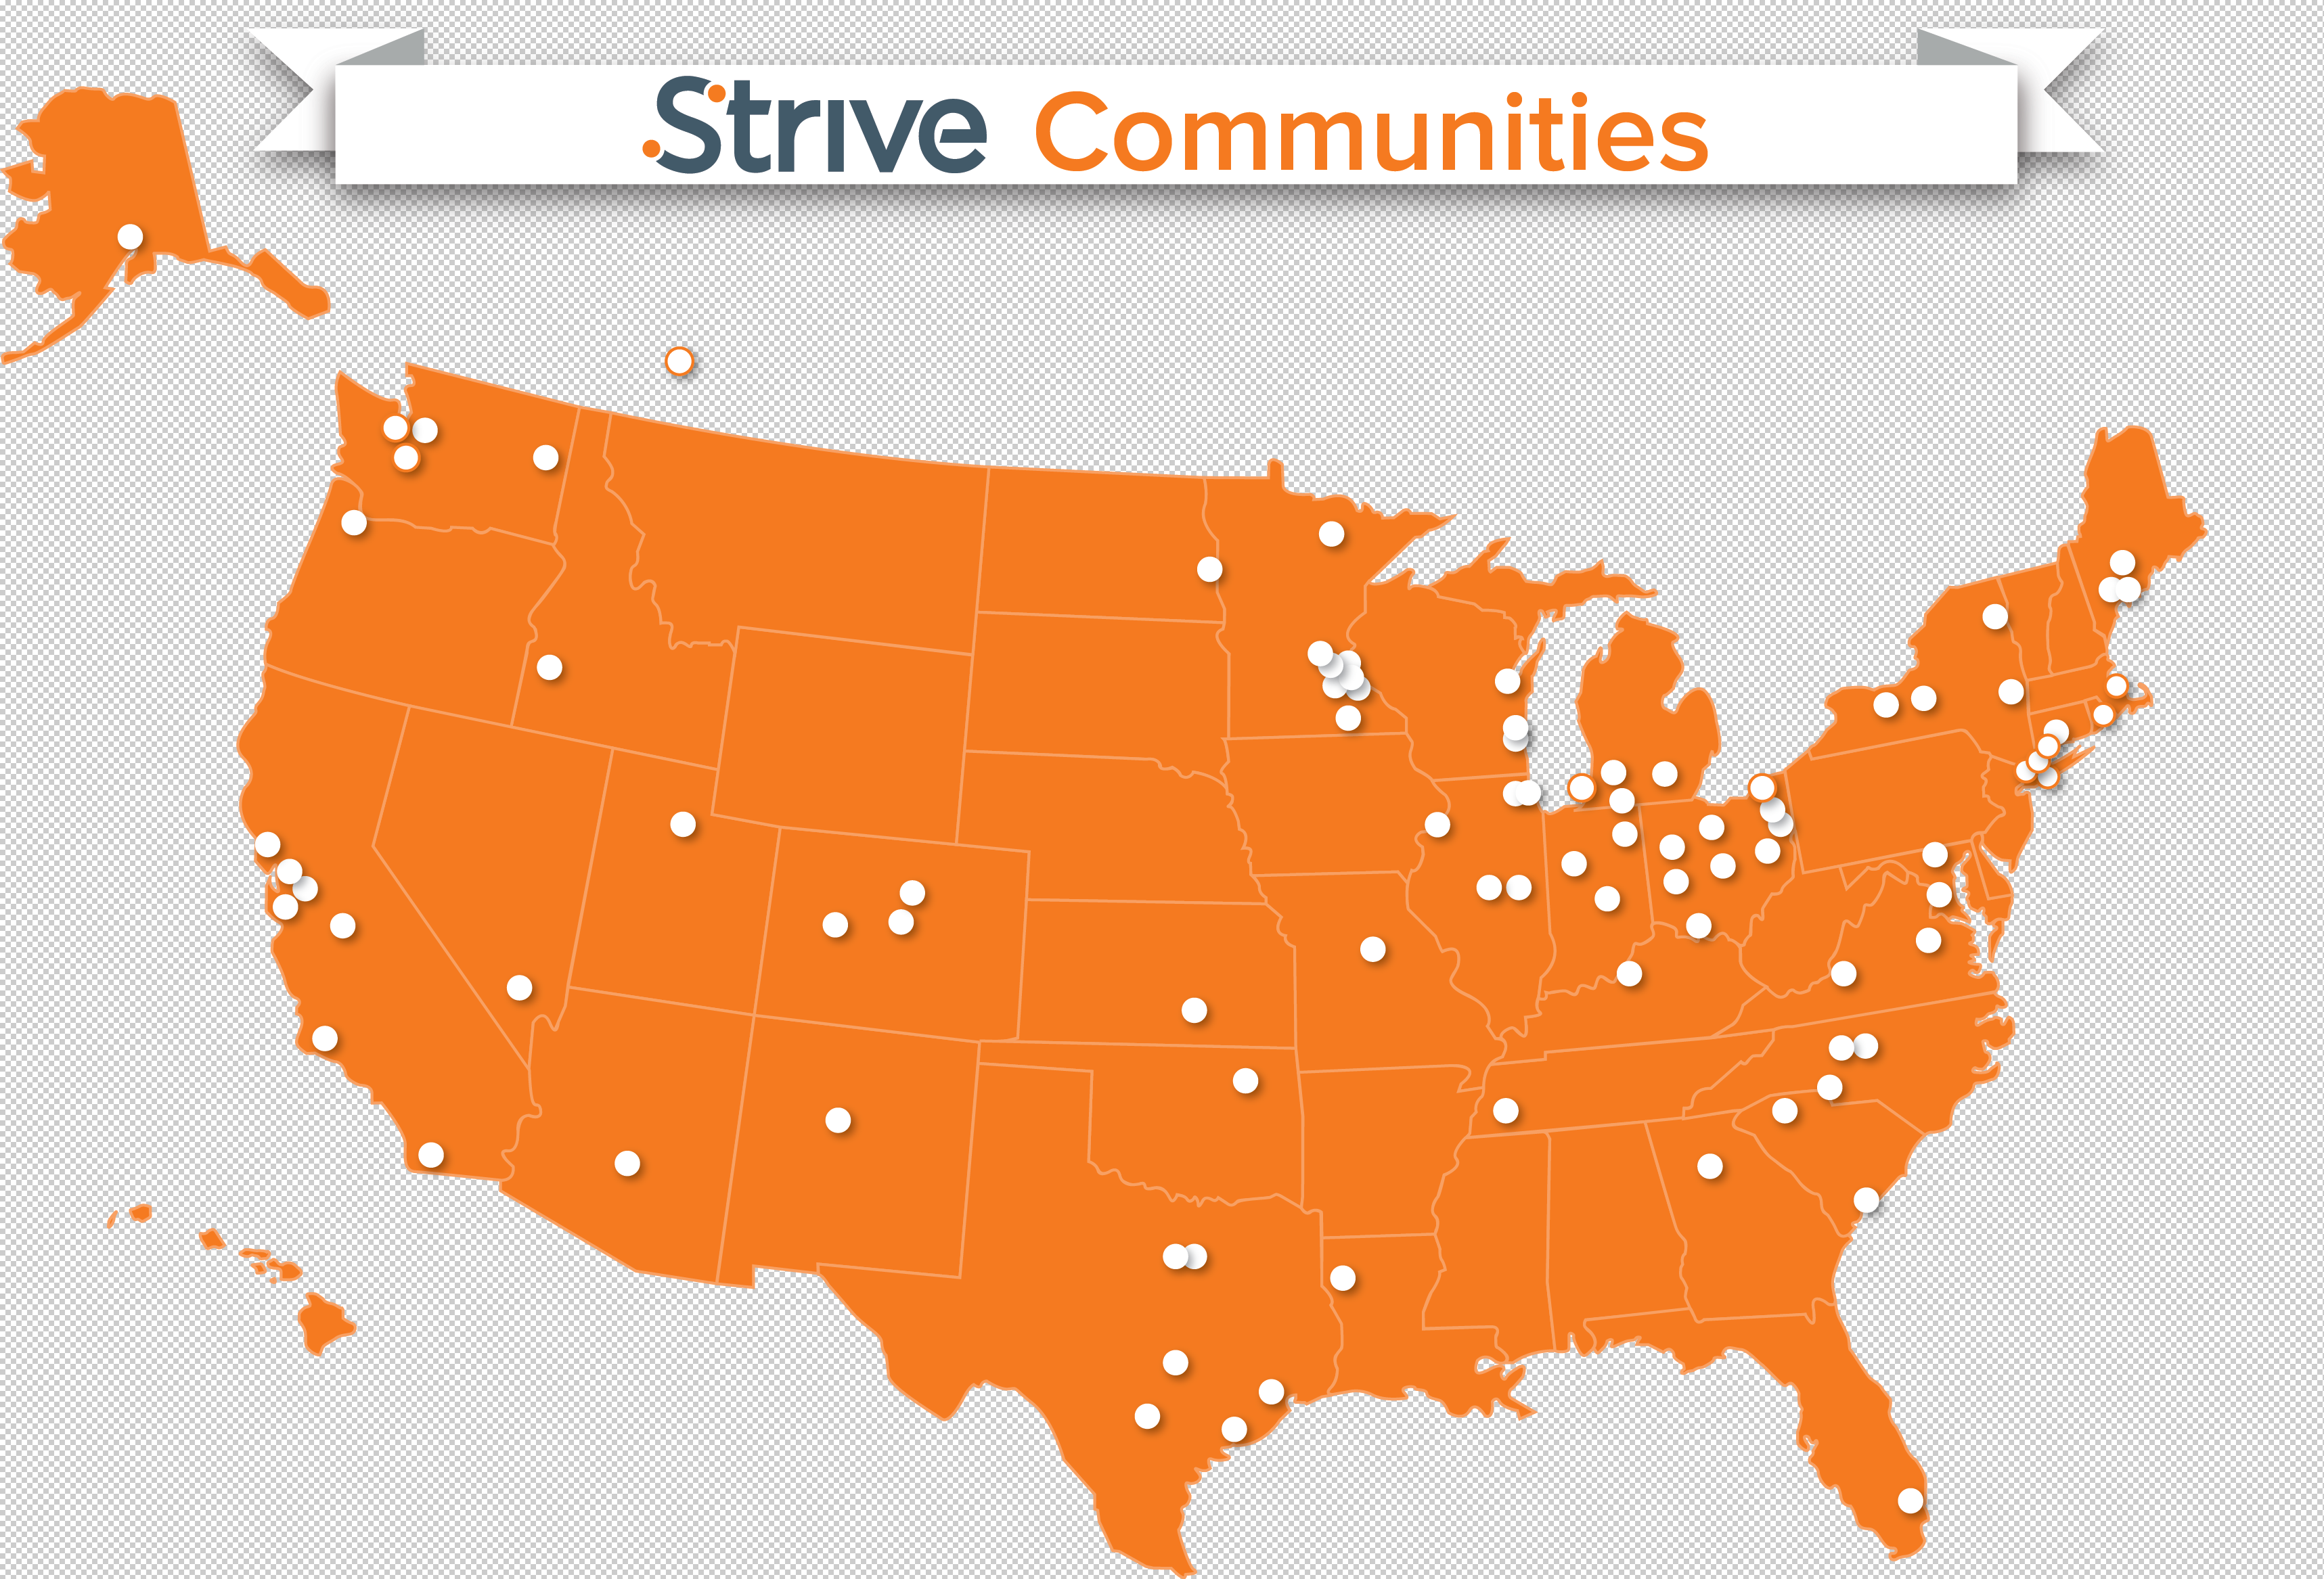
Australia
England
Germany

Slide 21



Does it
WORK?
+119%
2009 - 2012
+9%
2009 - 2011
+15%
2010 - 2013

Slide 23
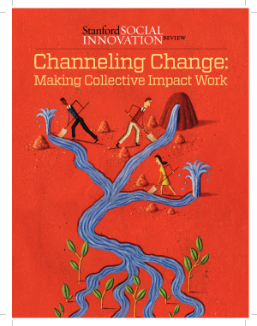
Notes:
Jeff

Slide 24
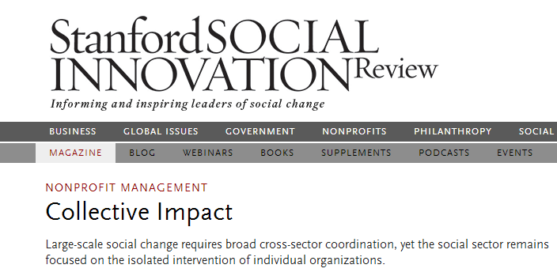
Five Conditions of Collective Success:
Common Agenda
Shared Measurement Systems
Mutually Reinforcing Activities
Continuous Communication
Backbone Support Organizations

Slide 26
What does this look like on the ground?

Slide 27


































Slide 28
Vision
Every child will have high-quality early learning programs and services; ambitious, rigorous and comprehensive education reforms; college- and career-readiness programs; and family and community supports, including improved family engagement in student learning through adult education opportunities
Mission
To develop a well-educated and well-prepared 21st century workforce that will revitalize the local and regional economy.
Education
Goals
Children enter kindergarten ready to succeed
Students are proficient in core academic subjects
Students successfully transition from middle to high school
Students graduate from high school
Graduates attain employment or a postsecondary degree/credential
Family & Community
Goals
Children are healthy
Children feel safe at school and in their community
Children live in stable communities
Family and community members support learning in schools
Children have access to 21st century learning tools

Slide 32
What makes “collective impact” unique?

Slide 33
Individual Action to Collaborative Action
Collaborative Action
A group working towards the same outcome,
Using disaggregated student/school level data
To continuously improve practices over time
Collective Impact
Coordinated Action
A group working on the same issue,
Sharing program information/design,
Align efforts around a similar issue or population
Cumulative Impact
Individual Action
Isolated Impact
Individual practioners working on specific issues,
Collecting qualitative and quantitative data for their individual programs,
Demonstrate impact with individual students

Slide 34
Collaboration
Collective Impact
Convene around
Programs/Initiatives
Work Together to Move Outcomes
Use Data to Prove
Use Data to Improve
Addition to
What You Do
Is What You Do
Advocate for What Works
Advocate for Ideas
Notes:
Jeff: This captures the real shift……

Slide 35


Using data to improve, not prove
Notes:
Best summed up by one of our partners: The Data Quality Campaign, StriveTogether believes that data needs to be used as a flashlight, shining light on the good work that is happening and helping to identify ways we can continuously improve what we do, rather than the traditional use of data as a hammer, punishing organizations or systems when scores slip.

Slide 36
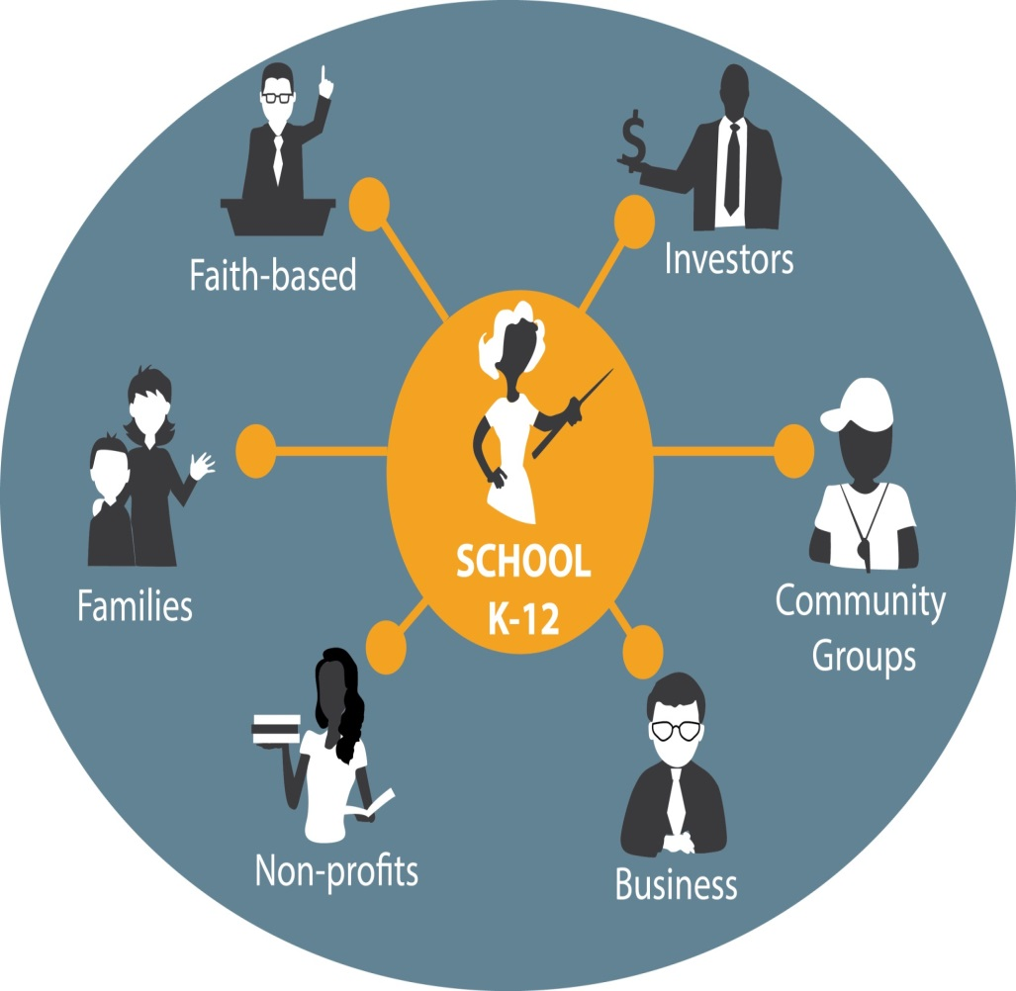
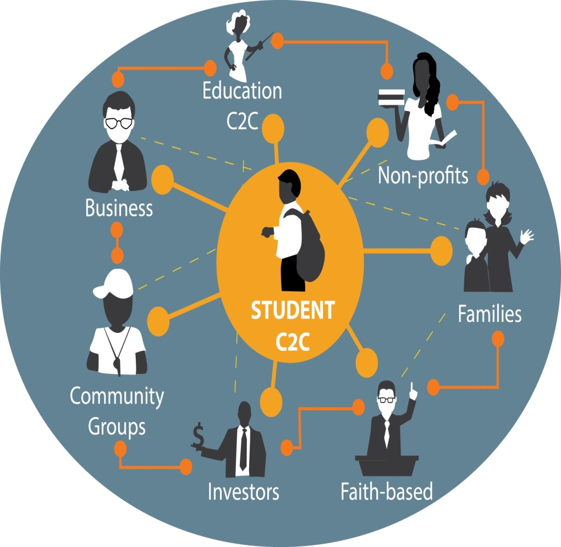

Slide 37
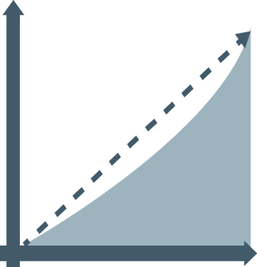


Cradle to Career
ACCELERATOR FUND
Capacity Building to Utilize Data Effectively
Targeting Local Investment to Scale What Works
Promoting Quality Collective Impact

Slide 38
“Educating more people, and educating them better, is simply the best bet any society can make.”
-DAVID LEONHARDT

Slide 39
College Changes Everything Conference
Nancy L. Zimpher, Chancellor
State University of New York
Chicago, IL
July 16-17, 2014

